Slide 1
Progress Report

Slide 2
Progress from last week
A better quantifier
  Now quantify the signal based on the average power, instead of peak power
  keep more detail when the PAPR is high.

Slide 3
Work in progress
Need to reassure that doing more than 0/1 quantify is beneficial.
  for a extreme case: if we have full knowledge on frequency domain, then 0/1 quantification on frequency is enough to know the support.
Current loss function for NN is mean square error.
  an error function frequently used in regression tasks
  not optimal in classification: sometimes “give up” and give all 0 prediction.
  possible alternative losses:
    categorical cross-entropy: for 40 subbands and 4 occupied bands, there are 91390 (combinatorial) classes.
    custom loss: can guide the NN to fit the criteria, but loss must be continous.

Slide 4
Quantify
I tested the effect of different quantify precisions
[0.089, 0.082, 0.084, 0.085, 0.091] Error rate
[0.427, 0.331, 0.333, 0.329, 0.362] False alarm rate
[0.595, 0.661, 0.692, 0.713, 0.810] Misdetection rate
Tested under 4:40:8 occupy:band number:coset
Cannot see a clear trend for error and false alarm rate
Misdetection rate goes up

Slide 5
Custom loss
misdetection
  1-(ones being correctly detected)/(ones being detected)
false alarm
  1-(ones being correctly detected)/(ones in the real data)
abstraction
  instead of calculating the ratio, we calculate the squared distance between vector a and b, filtered by a mask:
    vector a: output of NN
    vector b: real data
    mask: the corresponding base

Slide 6
Custom loss test
MSE loss
  error Rate: 0.064875
  False Alarm: 0.23875046485682405
  Mis Detection: 0.48824999999999996
Custom combined loss with 50%:50% ratio
  error Rate: 0.08175
  False Alarm: 0.422571064913025
  Mis Detection: 0.3195

Slide 7
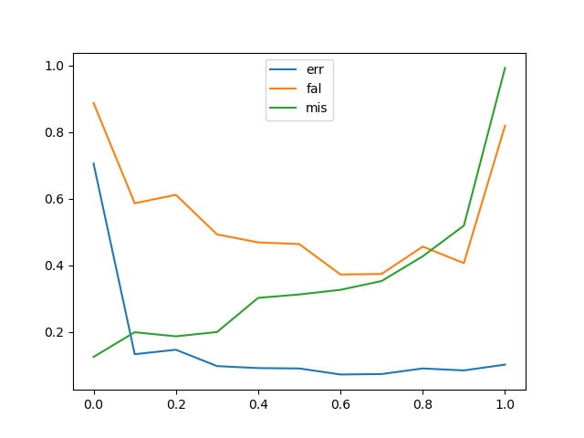
Custom loss test 2
x axis: ratio for false alarm loss in total combined loss
as the ratio of false alarm loss grows, we could see false alarm drops and misdetection rises, as a trade off
The total error rate is not changing much, the point on the both sides are probably caused by numerical problems as they does not show up when using the losses seperately.

Slide 8
Future work
loss for detection rate?
  detection rate is more complicated compared to the current custom loss
feed frequency data into NN?
  more computational burden on frontend, less burden on NN side?
regularization
  Currently the output can be more/less than the accually occupied bands.
    use cross-entropy could probably solve this, but introducing higher demand for training set
    can also be tackled using norm regularization

